Slide 3
Clinical Use of Silver Diamine Fluoride In Dental Treatment
May L. Bei,BDS,MDS,PHD; Edward Chin-Man Lo BDS,MDS,PHD, Chun-Hung Chu, BDS,MDS,PHD
Notes:
#117

Slide 4
Silver Diamine Fluoride
Colorless
Alkaline
Fluoride Ions
Silver Ions
38% Solution

Slide 5
Uses
Managing Caries in Children
Managing Root Caries in the Elderly
Desensitizing Teeth
Caries control/Off Label Use

Slide 6
Ammonia and Silver combine to form the Diamine-Silver Ion
More Stable than Silver Fluoride
Silver Ions are Bacteriocidal
Fluoride Ions promote remineralization

Slide 7
Development of a squamous layer on the exposed dentin, plugging the dentinal tubules. (Hydrodynamic theory of dentin hypersensitivity).
Increase resistance to acid dissolution and enzymatic digestion by bacterial proteases. Inhibits the proteins; matrix metalloproteinase, cathepsins and bacterial collagenases.
Act against bacteria in lesion by breaking membranes, denaturing proteins and inhibiting DNA replication.
“Zombie Effect” – when bacteria killed by silver ions are added to living bacteria, the silver is re-activated so that effectively the dead bacterial kill the living bacteria.
Increases in mineral density and hardness by formation of hydroxyapatite and fluorapatite along with presence of silver chloride and metallic silver.

Slide 8
Low Cost
Easy to Use
Black Stain
Metallic Taste
Gingival and Mucosal Irritation
May cause Fluorosis in Large Doses

Slide 9
Does not stain sound enamel
Many studies show no need for caries removal

Slide 10
Plastic-lined cover for counter, plastic-lined bib for patient
Standard PPE for provider and patient
One drop of SDF into the deep end of a plastic dappen dish
Remove bulk saliva with saliva ejector
Isolate tongue and cheek from affected teeth with gauze or cotton rolls
Apply petroleum jelly with cotton applicator around lip and gingiva
Dry affected tooth surfaces with triple syringe or dry with cotton
Bend microbrush, immerse into SDF, remove excess on side of dappen dish
Apply directly onto the affected tooth surfaces with microbrush
Allow SDF to absorb for up to 1minute if reasonable, then remove excess with gauze or cotton roll.
Rinse with water
Place gloves, cotton and microbrushes into plastic waste bags

Slide 11
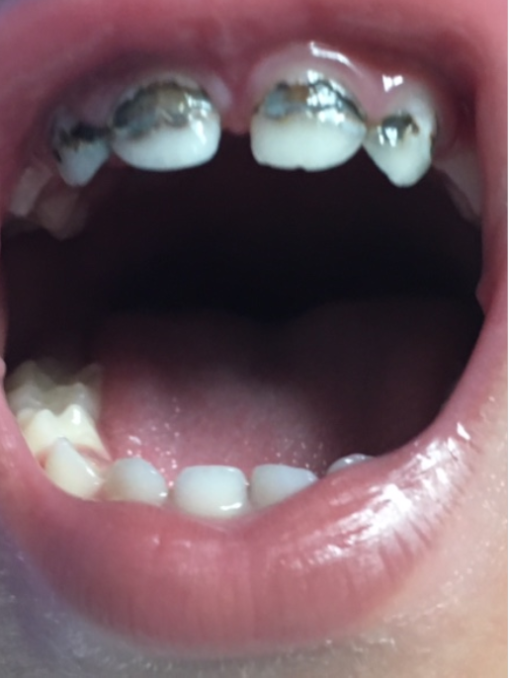

Slide 12
No consensus on frequency of application
Once a week for three weeks (this study) for caries control
Effective after 1 application for desensitivity

Slide 13
Managing Patients Using Novel Oral Anticoagulants(NOAs) in Dentistry; A Discussion Paper on Clinical Implications Constantinides, Rizzo,Pascalzo,Maglione

Slide 14
Purpose
To discuss how to approach patients on NOAs before, during and after treatment

Slide 15
NOAs
Pradxa (Dabigatran Etexilate)
Xarelto (Rivaroxaban)
Eliquis (Apixaban)

Slide 16
Advantages
Antagonists at very specific steps of coagulation
Provide stable anticoagulation at a fixed dose
No need to monitor with lab exams

Slide 17
Advantages
No INR
Rapid Onset
Rapidly reach peak concentration
Wide therapeutic margin
Low drug to drug interactions
No significant food interactions

Slide 18
Methods
Reviewed Literature through 2012

Slide 19
Pradaxa
Direct Thrombin Inhibitor
Binds to Thrombin and prevents Fibrinogen/Fibrin

Slide 20
Re-Ly
18,113 Patients
Lower rates of stroke and embolism than Warfarin
No Monitoring
Has a reversal agent (Idarucizumab)
Notes:
A-Fib

Slide 21
Dental Considerations
DTI similar to Warfarin with INR of 2-3
Vitamin K antagonists with INR less than 3
No direct interaction with NSAIDs

Slide 22
Modification of Tx
Renal Function
Complexity and length of Procedure
Patient Dependent Factors (age, aspirin)

Slide 23
Xarelto
Factor Xa Inhibitor
Indicated for Use in Hip and Knee Rplacement Surgery
Prevention of Cerebrovascular complications in non-valvular A-Fib
DVT

Slide 24
Rocket- AF Study
14,236 patients
Significant decrease in stroke and embolism compared to Warfarin

Slide 25
Dental Considerations
No need to discontinue for simple extractions in patients with normal Renal function
No need to discontinue for routine procedures

Slide 26
Eliquis
Factor Xa Inhibitor
Same Indications as Xarelto

Slide 27
Aristotle Study
9260 Patients
Peak Plasma Levels in 1-3 hours
12 Hour ½ Life
Excreted almost totally in Bile

Slide 28
Summary
No need to discontinue for routine procedures
Consider if over 5 extractions or surgery over 45 minutes

Slide 29
Articaine Buccal Infiltration Vs Lidocaine Inferior Block- A Review of the Literature
G. Bartlett and J. Mansoor
Notes:
#83

Slide 30
Purpose
Compare the effectiveness of Articaine buccal infiltrations and Lidocaine Blocks in mandibular Molars

Slide 31
Articaine
Derived from thiphene not benzene
More lipid soluble
More potent, faster onset

Slide 32
Methods
Literature Review
27 Studies

Slide 33
Methods
Compared 4% Articaine Infiltration vs 2% Lidocaine IAN block
Permanent teeth only
Adults only
Mandibular Molars only
Success = pulpal anesthesia

Slide 34
Only 2 studies met these criteria
Randomized double-blind studies

Slide 35
Results
Success rate of 56-70% for Blocks
Success rate of 65-70% for infiltrations

Slide 36
Conclusion
No significant difference

Slide 37
Management of Patients with Cardiovascular Implantable Electronic Devices in Dental, Oral, and Maxillofacial Surgery
James Tom, DDS
Notes:
#34

Slide 38
Review Article
3 Million patients with Pacemakers or Implantable Cardioverter Defibrillators
250,000 new patients annually
Electromagnetic Interference

Slide 39
Current Recommendations
Consultation with physician if within 30 days or if any change in medical history
Consultation for any sedation/general anesthesia

Slide 40
Electrosurgery
If using electrosugery, keep electrode dispersal pads as far away from CIED as possible and keep exposure times short

Slide 41
Minimal EMI from:
Apex Locators
Light Curing Units
Handpieces
Piezoelectric Dental Scalers
Lasers

Slide 42
Very little EMI from Dental Imaging
No effect from local anesthesia

