Slide 1
SPECIAL CARE
ADVOCATES
IN
DENTISTRY
2017 ANNUAL SEMINAR
LITERATURE REVIEW
Drs. Mannie Levy and Doug Veazey

Slide 2


Slide 3
Effect of Occlusal Calculus utilized as a potential “biological sealant” in special needs patients with gastric feeding tubes (gft): a qualitative in vitro contrast to pit and fissure sealant restorations
                GENERAL DENTISTRY
                JULY/AUGUST 2016
                UNIVERSITY OF TENNESSEE
                MEMPHIS

Slide 4
Studies have shown that SNPs receiving nutrition via a GFT exhibit significantly greater levels of calculus formation, and at a higher rates, than do non-GFT, orally fed populations, irrespective of oral hygiene regimens.
Evidence as to why patients with a GFT experience a greater incidence of periodontal disease and lower incidence of caries is also inconclusive.

Slide 5
Among the speculated causes are the decrease or absence of oral nutrition intake, alterations in salivary pH, differences in salivary calcium and phosphate electrolyte levels, and regurgitation of GFT constituents.
The mineralization process of calculus typically occurs as dental plaque is saturated with calcium, phosphates, and carbonates from the saliva. Calculus formation is facilitated by a sustained salivary and/or oral plaque
ph of 5.5 or greater.
Saliva pH in healthy person = 7.1 to 7.5

Slide 6
Data suggests that salivary and plaque pH could be higher in SNPs, especially when a GFT is involved.
Because GFT nutrition does not provide fermentable carbohydrates necessary for acid generation in oral plaque and subsequent development of dental caries, these formulas promote the accumulation of calculus in an alkaline environment.
The increase in pH also results in decreased levels of oral cariogenic bacteria and a lower incidence of clinical caries, regardless of the oral hygiene regimen.
Clinically, calculus appears dense and impenetrable to removal, but in fact is relatively porous.

Slide 7
Conclusion: No marginal microleakage was noted in the calculus specimens, indicating that this substrate may serve as a “natural” occlusal surface sealant and that its removal from occlusal surfaces during routine oral prophylaxis may be Unnecessary.

Slide 8
The pH of beverages available to the American consumer
                Journal of American Dental Association
                April 2016

Slide 9
2004 total consumption of soft drink/fruit drinks for every man, woman, and child was approximately 68 GALLONS per year.
Acids are added to beverages and compose a flavor profile giving the beverage a distinctive taste. Acids provide a tartness and tangy taste that helps to balance the sweetness of sugar.
Phosphoric acid- in cola drinks for tartness, reduce growth of bacteria and fungi, and improve shelf life.
Citric acid- for tartness & preservative.
Malic acid- in many fruit drinks to enhance flavor. Also in artificially sweetened beverages.
Carbonic acid- carbonated water

Slide 10
Teeth erode in the pH range of 2.0-4.0, although surface enamel starts to demineralize as the pH drops below 5.5.
Dental erosion from beverages is primarily caused by phosphoric acid and/or citric acid.
Fluoride DOES NOT prevent erosion since highly acidic environments solubilize fluorapatite and calcium fluoride.
Saliva is an important milieu for the negation of dental erosion by not only diluting and buffering extrinsic acids, but also providing the source of glycoproteins that coat the tooth surface as the protective pellicle.

Slide 11
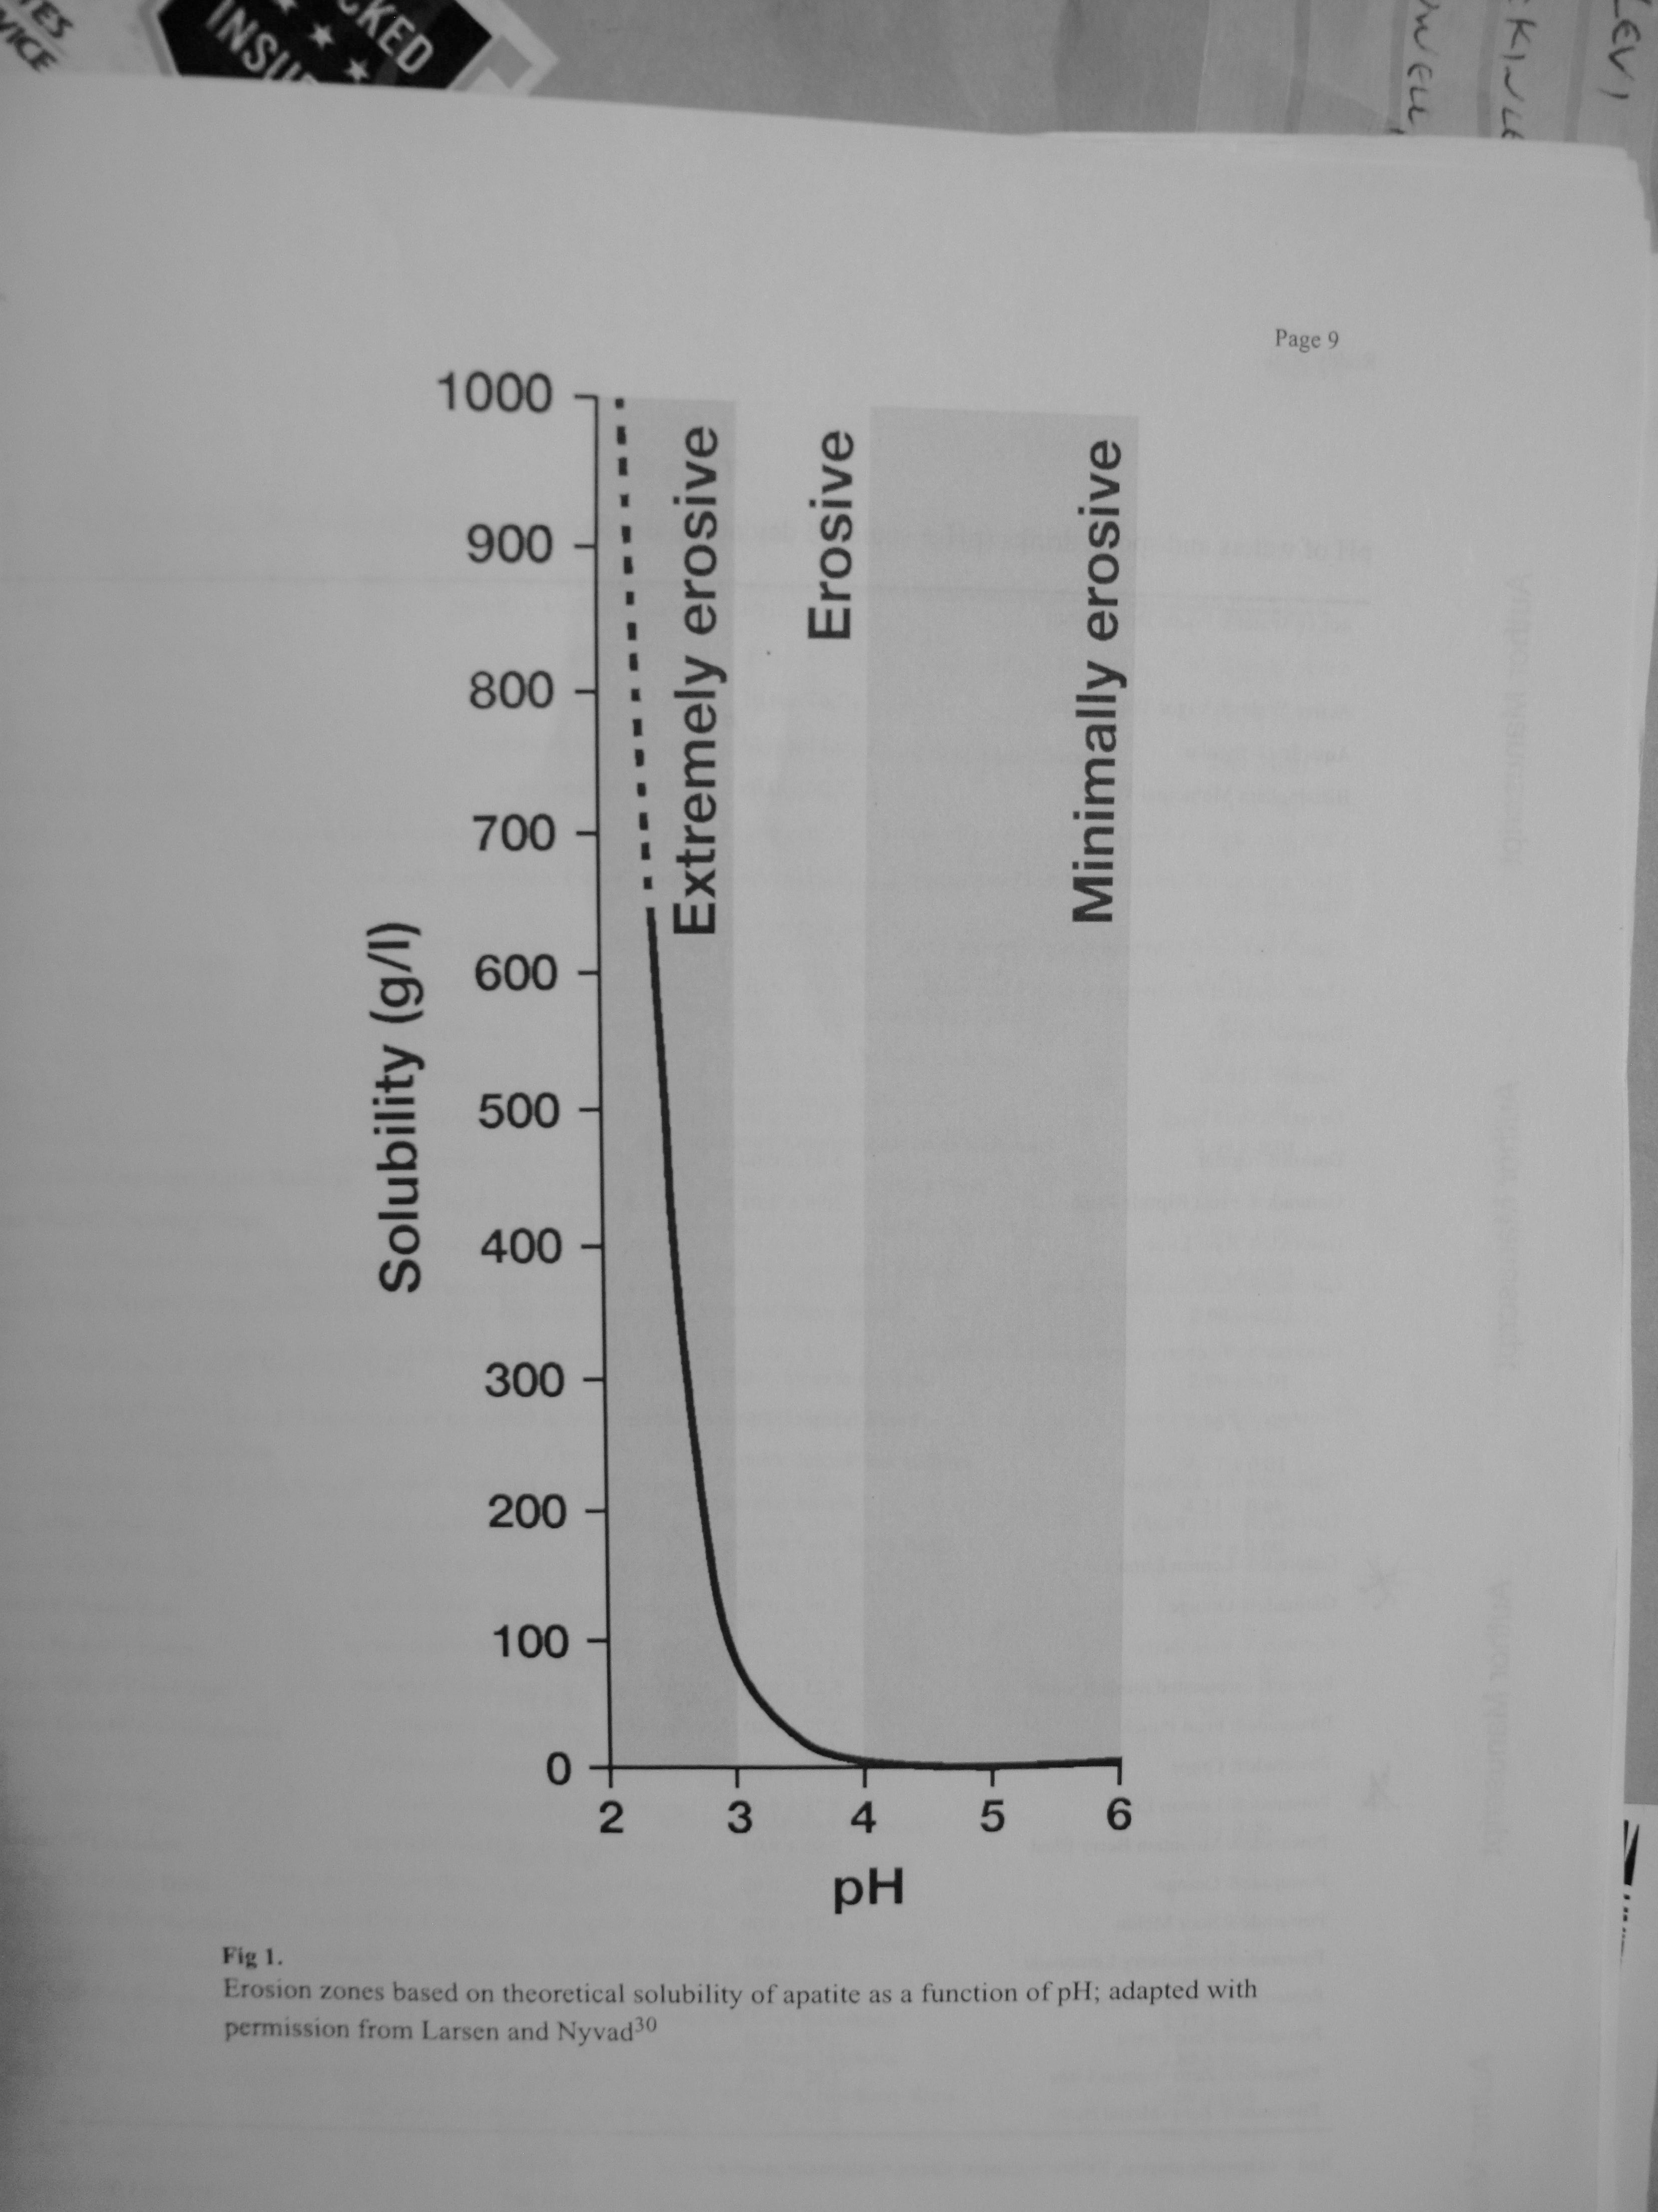

Slide 12
380 beverages were tested for pH. 93% had a pH below 4 (erosive or extremely erosive).
Battery Acid= 0
Gastric Acid= 1 (reflux) (bulimia)
Lemon Juice = 2.25
Coke Classic = 2.37
Pepsi = 2.39
Kool Aid mix Tropical punch = 2.69
5 hr energy Berry = 2.81
Dr. Pepper = 2.88
Lipton Green tea with citrus = 2.93
Coke Zero = 2.96
Gatorade Orange =2.99
Vitamin water Orange = 3.23
7 up = 3.24
Carbonated water=carbonic acid= 5
Coffee = 5.11

Slide 13
Evidence-based recommendations for antibiotic usage to treat endodontic infections and pain
Journal of the American Dental Association
March 2016
Case Western Reserve, Ohio

Slide 14
Reviewed 5 different studies.
With sample sizes 80,40,40,41,70 patients.
Conclusion: The best available clinical evidence signals NO indication for prescribing antibiotics preoperatively or postoperatively to prevent endodontic infection or pain unless the spread of infection is systemic, the patient is febrile, or both.
Systemic administration of antibiotics does not relieve painful pulpitis nor does it resolve localized periradicular symptons.

Slide 15
Are Topical Fluorides effective for treating incipient carious lesions?
A Systemic review and meta- analysis
Journal of American Dental Association
February 2016

Slide 16
In active incipient carious lesions, fluoride is accumulated on bacterial plaque and saliva as calcium fluoride as a result of topical fluoride applications.
Biofilm control itself is an effective way to arrest enamel carious lesions because it promotes mechanical abrasion of the enamel surface, and clinically leads to change in the appearance of white spots from chalky and rough (active) to bright and smooth (inactive).
Active lesions indicate that the reservoir of Fl formed from Fl toothpaste and fluoridated water has not been enough to positively affect the demineralization- remineralization process.

Slide 17
A systematic review has evidenced that sealants are more effective than Fl varnish in caries prevention on occlusal surfaces.
Studies and Conclusion:
4 applications at weekly intervals or 2 applications of Fl varnish over 4 mos. were effective in reversing active enamel caries lesions in primary dentition. 81% lesions were inactive with Fl varnish Vs. 38% arrested in no tx. Group.
3 applications with quarterly intervals on permanent teeth lead to significant decrease in caries prevalence Vs. control group over 7 mo. Interval.

Slide 18
Sleep quality in patients with xerostomia: a prospective and randomized case-control study
Acta Odontologica Scandinavica
October 2015
Spain

Slide 19
Sleep disorders add to the pathological gravity of any illness and diminish general wellbeing.
Numerous articles of research have indicated that saliva flow follows circadian rhythms and decreases during sleep.
The results of the present study suggest an association between hyposalivation, sleep disorders, oral quality-of-life and psychiatric disorders among xerostomia patients in comparison with control subjects.

Slide 20
Nonodontogenic “tooth pain” of nose and sinus origin
Journal of American Dental Association
June 2016
Minnesota

Slide 21
Case #1-
35 yo female with constant achy, throbbing pain located in maxillary anterior area. 3-5:10.
Pain of 3 mos. duration after bike fall. Endo to
#8 & 9 with apico #9.
Dx. Nasal vestibulitis- diffuse dermatitis of nasal vestibule. Often caused by Staph. Aureus. Skin in nose is red, swollen, and tender

Slide 22
Case #2-
57 yo woman with hx. of constant deep ache. Rated 5:10. Has had 14 dental procedures over 5 yrs to Maxillary Right (endo., root end surgeries, extractions, & implants).
Last few weeks pain up to 8:10. On IV antibiotics from Infectious Disease MD.
Medical Hx. significant for chronic sinusitis and multiple sinus surgeries.
Dx: Neuropathic facial pain, aggravated by recurrent sinusitis, further complicated by mucociliary dysfunction. (Mucociliary apparatus consists of cilia, protective mucous layer, and airway surface liquid layer which work in concert to remove inhaled particles.)

Slide 23
Maxillary teeth, maxillary sinuses, and the anterior 2/3 of the nose are innervated by branches of the maxillary division (V2) of the trigeminal branch-( 5th cranial nerve.)
Branches of Trigeminal –V1 Opthalmic
V2 Maxillary
V3 Mandibular
Inflamed sino-nasal tissues can lead to sensitization of branches within the Maxillary division of Trigeminal. Teeth in area of sinus may have sensitivity to biting, thermal, and percussion.

Slide 24
An examination of factors related to aspiration and silent aspiration in older adults requiring long-term care in rural japan
Journal of Oral Rehabilitation
2016

Slide 25
Swallowing disorders are a growing problem among elderly in LTC, and can cause aspiration pneumonia.
Silent Aspiration (SA)- is defined as aspiration without clinical signs such as coughing or throat clearing. Described in many conditions and subgroups- including normal individuals. Some degree of SA at night may be normal in healthy individuals.
Examination of oral function is essential when investigating dysphagia. Importance of lip closure,& lingual ability to stick tongue out.
Dementia severity was the best predictor of suspected SA.

Slide 26
Transmission of blood-borne pathogens (BBP) in US dental health care setting- 2016 update
Journal of American Dental Association
September 2016
CDC- Atlanta

Slide 27
BBPs of primary concern include HBV, HCV, and HIV.
This update was review of literature from 2003 through 2015.
Identified 3 episodes of BBP transmission in US dental settings. Will give details
Since 1987, there have been NO transmissions of HBV or HCV in dental setting that involved an infected dentist or oral surgeon.
The hepatitis B vaccine became commercially available in 1982.

Slide 28
Case #1-2002 Oral Surgeon Practice
Patient to patient transmission of HBV. Source patient had chronic HBV with high viral load and had 3 ext. Index patient had 7 exts. 27 patients notified for BBP screening.
Office staff had been vaccinated for HBV and reported that they followed standard infection prevention and control practices.
Investigators could only speculate that virus had been spread via environmental surfaces despite good cleaning practices.

Slide 29
HBV is a hardy virus that has been demonstrated to survive in dried blood at room temperature on environmental surfaces for AT LEAST ONE WEEK.
HBC can survive in the environment for up to SIX WEEKS on dry surfaces, although most HBC transmissions occur through percutaneous exposure.

Slide 30
Case #2-2009 Free dental school clinic in gym
5 cases of HBV infection. 3 were patients and 2 were DHCP. 1,500 people notified for BBP screening. Dental Tx. provided was Exts. and prophylaxsis.
Multiple procedural and infection prevention controls were breached- Ex. Handpieces were cleaned with disinfectant wipes rather than being heat-sterilized. Some instruments were sterilized unwrapped. Areas were in close proximity without physical barrier.
DHCPs were not always using PPE when handling contaminated items and splashed in face with fluid from suction container. Also all DHCPs had not received infection control training.

Slide 31
Case #3-2013 Oral Surgery Practice
HCV infection. Source patient had multiple Ext. Index patient had Ext., bone graft, and implant. 5,810 patients notified for BBP screening.
Multiple lapses in infection control- most related to administration of IV meds by unsupervised, unlicensed, and untrained dental assistants. Contaminated medication vials used on more than 1 patient was the likely mode of transmission.
Possible routes of transmission included improperly sterilized dental equipment or environmental contamination.

Slide 32
Conclusion-
Some investigators may not have reported or linked transmission of BBP in dental settings with dental tx. because of the long incubation period (up to 6 mos.) for HBV and HBC.
Also reporting may be off due to asymptomatic course of acute infection for viral hepatitis and sometimes for HIV infection.
And limited resources in state and local health departments to follow up on viral hepatitis cases that lacked data on risk factors.
The CDC Guidelines for Infection Control in Dental Health Care Settings-2003 remains the standard of care for the profession.

Slide 33


